Slide 1
Frameworks / Product Lines
The frame for reuse
Henrik Bærbak Christensen

Slide 2
Motivation
I have presented some design principles
  3-1-2 process: encapsulate variation, program to an interface and compose behaviour using delegation
  Compositional design
    it is better to reuse code by delegation than inheritance
    let someone else do the dirty job
  Iterative and Incremental search for variability
    supported by TDD
    supported by refactoring
... and on the way we discovered some patterns
Henrik Bærbak Christensen

Slide 3
Abstracting
What I have actually done is to show you the pieces that together form the puzzle called frameworks:
Framework:
  A framework is a set of cooperating classes that make up a reusable design for a specific class of software.
Exercise:
  Is the pay station a framework given this definition?
  Argue why MiniDraw is a framework.
[GoF]
Henrik Bærbak Christensen

Slide 4
Framework Characteristics
A framework is characterized by
  reuse of both design as well as executable code
  reuse within a well defined domain
    Swing is for GUI’s, not for banking…
  high reuse percentage (70-90%)
  must be customized for customer’s particular need
Example:
  HP printer software
  Eclipse IDE plug-in architecture
  CelciusTech C&C for ships
  Java Swing
Henrik Bærbak Christensen

Slide 5
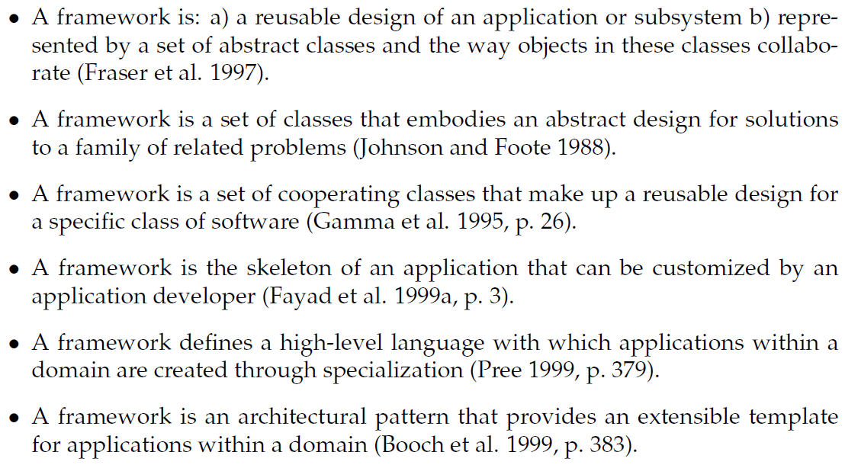
Other Definitions
DAIMI
Henrik Bærbak Christensen
Henrik Bærbak Christensen

Slide 6
Common aspects of the definitions
Skeleton / design / high-level language
  … provide behaviour on high level of abstraction: a design/skeleton/architecture
Application/class of software
  … has a well defined domain where it provides behaviour
Cooperating / collaborating classes
  … define and limit interaction patterns (protocol) between well defined roles
Customize/abstract classes/reusable/specialize
  … can be tailored to a concrete context
Classes/implementation/skeleton
  ... is reuse of code as well as reuse of design
DAIMI
Henrik Bærbak Christensen
Henrik Bærbak Christensen

Slide 7
Variability points = Hotspots
Henrik Bærbak Christensen

Slide 8
Applications made from frameworks
A framework based application is composed of three portions of code
  The framework code (external, third party)
  The framework customization code (our own code)
  Non-framework related code (own code)
Example: Backgammon project
  MiniDraw framework (basic GUI control)
  Customization code (adapt MiniDraw til BG graphics)
  Backgammon domain code (move validation, turn control, dice rolling, etc.)
Henrik Bærbak Christensen

Slide 9
Which leads to...
Traditionally one distinguish between
  Developers: Developing the software for end users
  End users: Using the software
Frameworks require one additional role
  Framework developers: Develops the framework
  Application developers: Adapt the FW for users
  End users: Using the software
I.e.: The end users of a framework are themselves software developers!
Henrik Bærbak Christensen

Slide 10
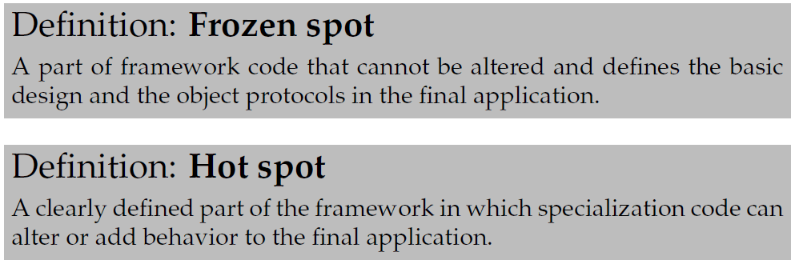
HotSpots…
”Separate code that changes from
the code that doesn’t”
Hot spots are also known as:
  Hooks / hook methods
  Variability points (our favourite term)
Henrik Bærbak Christensen

Slide 11
Example
The pay station system has hotspots regarding
  receipt type
  rate policy
  display output
  weekend determination
but frozen spots, fixed behaviour, concerning
  coin types (payment options), numerical only display, only buy and cancel buttons, etc.
Domain: Pay stations
  no reuse in the electronic warfare domain ☺
Henrik Bærbak Christensen

Slide 12
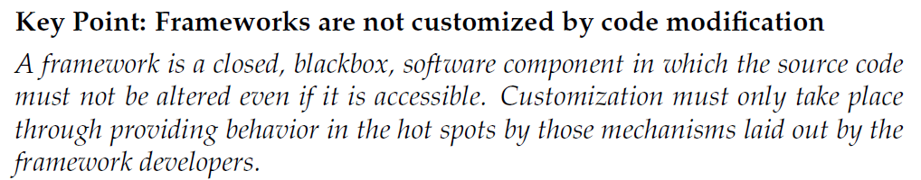
Frozen spots
Frozen is important : keep the code in the fridge!
Code modifications means unthawing and freezing again   
Henrik Bærbak Christensen

Slide 13
Why...
I have realized that this point is so natural to me that I have more or less forgotten to emphasize it.
Why
  Consider Java Swing
    If you had to rewrite code in 8 different places in the Swing library to add a new special purpose visual component
  Then you had to
    Understand the Swing code in deep detail (costs!)
    Reintroduce special purpose code everytime Sun/Oracle releases a new version of Swign (costs!!!)
Henrik Bærbak Christensen

Slide 14
Morale
You adapt a framework to your particular needs by
  Change by addition, not by modification!!!
You
  Implement interfaces or extend existing classes
    Concrete implementations, real behaviour filling out the responsibilities defined by the framework
  Tell the framework to use your implementations...
Henrik Bærbak Christensen

Slide 15
Which again leads to...
If the framework has to use my concrete implementations then...
It cannot itself create these objects
  If MiniDraw itself had
    Drawing = new StandardDrawing();
  Then it was an application (fixed behaviour), not a framework (adaptable behaviour).
Then ... How can it create objects?
Henrik Bærbak Christensen

Slide 16
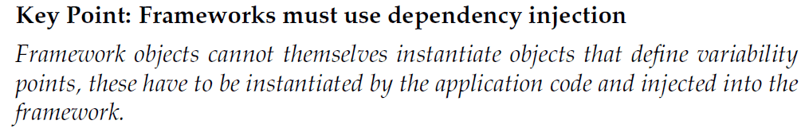
Dependency Injection
Typically an (OO) framework would use factory techniques like abstract factory
  Or prototype or factory method patterns...
Henrik Bærbak Christensen

Slide 17
Customization Techniques
Henrik Bærbak Christensen

Slide 18
Techniques to define hotspots
We have object oriented composition to define hotspots. We have also looked at other techniques
  Parameterization, overriding superclass methods
Henrik Bærbak Christensen
Notes:
Jump tables in assembler, function pointers in C, higher order functions in functional languages, procedure parameters in Pascal

Slide 19
HotSpots
Exercise: List techniques to make the hotspots
  Hint: Consider techniques used in
    MiniDraw
    Swing
    Java RMI
    Collection classes
    Eclipse
    C library sorting algorithms
    Intel 486 interrupt vector handling
    Functional languages
Does a Framework require object-orientation?
Henrik Bærbak Christensen

Slide 20
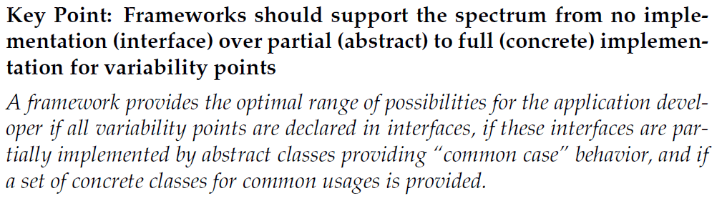
A good framework...
... Must give ”return on investment”
  Investment: ”I have to learn how to use it”
  Return: ”I get reliable software that does a lot”
Swing/MiniDraw/...
  Consider writing Swing yourself!
Henrik Bærbak Christensen

Slide 21
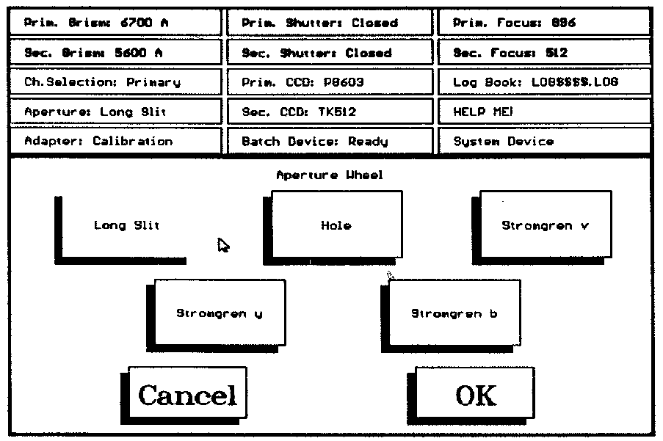
In the old times...
Henrik Bærbak Christensen

Slide 22
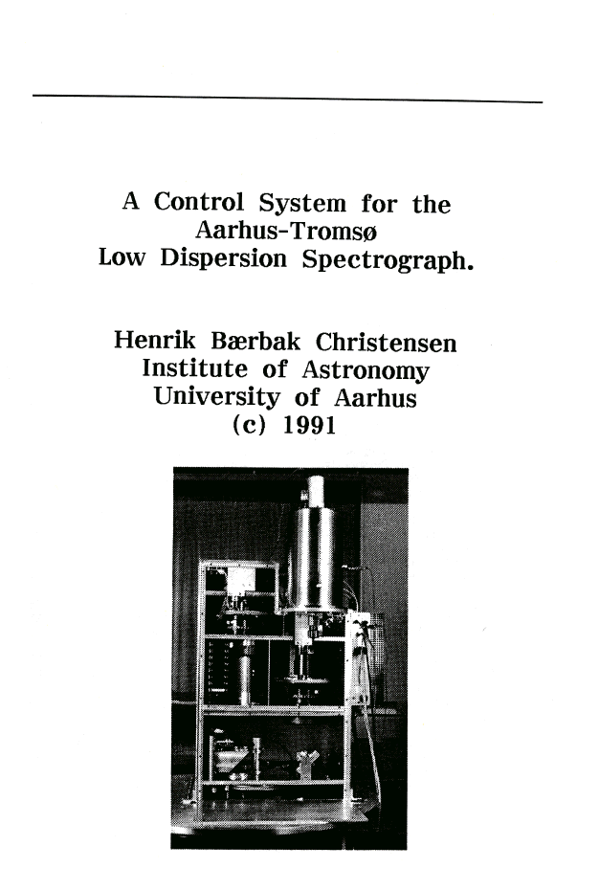

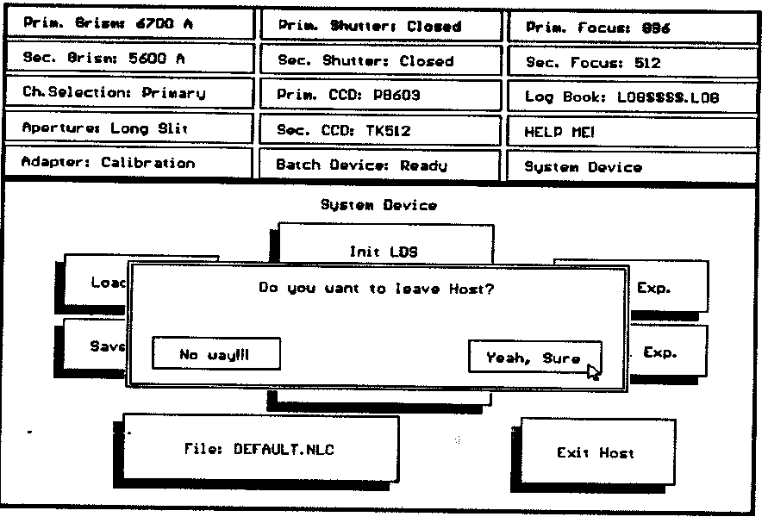
Henrik Bærbak Christensen

Slide 23
Framework Protocol

Slide 24
Design and Code Reuse
“Cooperating / collaborating classes
  … define and limit interaction patterns (protocol) between well defined roles”
Frameworks require users (=developers) to understand the interaction patterns between objects in the FW and their own customization objects. That is, understand the protocol.
  Ex: Understand the editor↔tool protocol in MiniDraw
  One TA tried to invoke activate on a tool (and ended with an infinite loop)
    activate is a method called by MiniDraw when a tool is activated!
Henrik Bærbak Christensen

Slide 25
Where is the protocol?
So: The framework dictates the protocol!
The question is: How?
Henrik Bærbak Christensen
Notes:
The

Slide 26
Protocol
The protocol arise because objects in the framework invokes methods on objects that are defined by you.
These methods/functions/procedures that are predefined by the framework to be ‘overridable’ or customizable are the hotspots.
A framework contains frozen code with embedded hotspots where your (unfrozen) code may be called.
Henrik Bærbak Christensen

Slide 27
Inversion of Control
This property of frameworks is called
Inversion of Control
(”Hollywood principle: do not call us, we will call you.)
The framework dictates the prototocol – the customization code just has to obey it!
Henrik Bærbak Christensen

Slide 28
Compare ‘traditional’ reuse
Another type of reuse of code (more than design) is libraries
I have never written my own cosine function – have you?
There are lot of libraries of usable behavior out there that does not invert control.
Henrik Bærbak Christensen

Slide 29
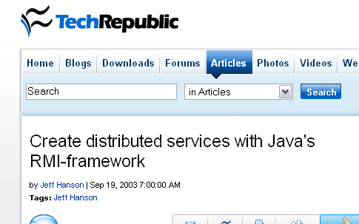
Inversion of Control
Note: inversion of control is not a ’required’ characteristics of a framework in some author’s view
  RMI is an example. The control inversion is difficult to spot...
  (but why is it
  not just a library
  then???)
Henrik Bærbak Christensen

Slide 30
Template Method
The central OO pattern to separate frozen and hot code
The core of the inverted control
Henrik Bærbak Christensen

Slide 31
Template Method
Intent (Original GoF statement)
  Define the skeleton of an algorithm in an operation, deferring some steps to subclasses. Template Method lets subclasses redefine certain steps of an algorithm without changing the algorithm's structure.
Restatement
  Some steps in the algorithm are fixed but some steps I would like to keep open for future modifications to the behaviour
Henrik Bærbak Christensen

Slide 32
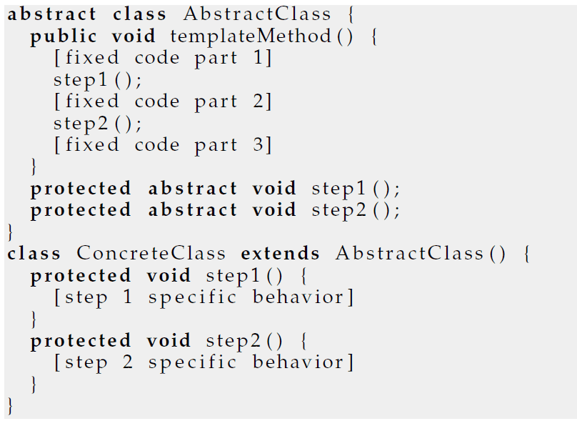
GoF Structure
The structure in GoF is that of subclassing
Henrik Bærbak Christensen

Slide 33
The Multi-Dimensional Variability
Subclassing handles multi-dimensional variability very badly...
Consider
  Three variants of step1() required
  Four variants of step2()
  Any combination feasible
How many subclasses?
Henrik Bærbak Christensen

Slide 34
Conclusion
Conclusion:
Favour object composition
over class inheritance
Henrik Bærbak Christensen

Slide 35
Exercise
Rewrite the GoF structure to its compositional equivalent that is behavioural equivalent but follows the three principles of flexible design.
Henrik Bærbak Christensen

Slide 36
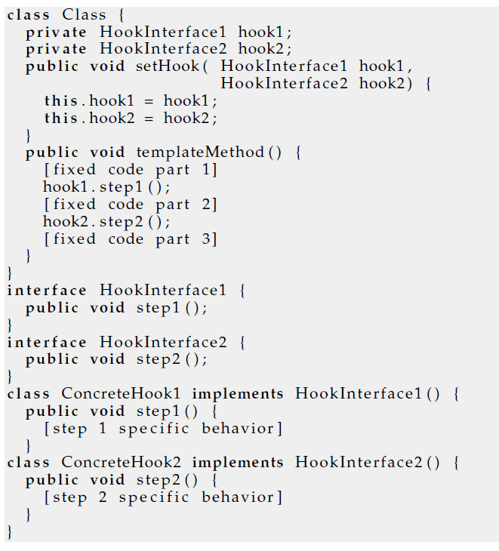
Find the error in the Book
The book’s code is not wrong but it misses the point in supporting multi-dimensional variability ☹
Improved version:
Henrik Bærbak Christensen

Slide 37
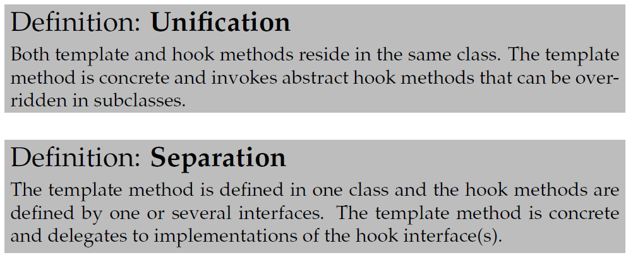
Template Method Terminology
These two variants have a name:
  Original: subclassing+override hook methods
  New: interface implementation + delegate to hooks
Henrik Bærbak Christensen

Slide 38
Exercise
Identify template method in the pay station:
public void addPayment( int coinValue ) {
switch ( coinValue ) {
case 5:
case 10:
case 25: break;
default:
throw new IllegalCoinException("Invalid coin: "+coinValue+" cent.");
}
insertedSoFar += coinValue;
_timeBought = rateStrategy.calculateTime(insertedSoFar);
}
Henrik Bærbak Christensen

Slide 39
Exercise
How does template method relate to the inversion of control property of frameworks?
Henrik Bærbak Christensen

Slide 40
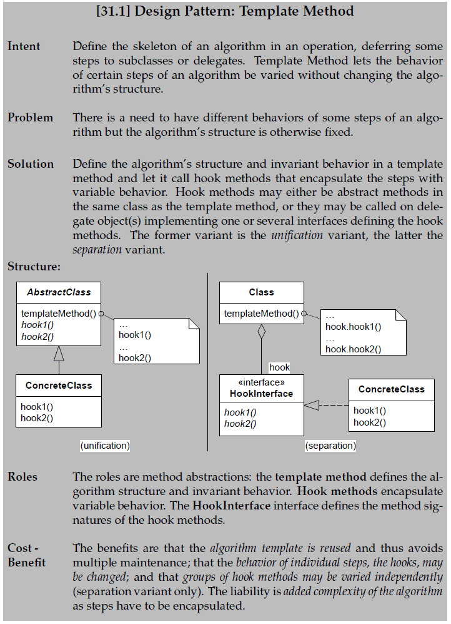
Henrik Bærbak Christensen

Slide 41
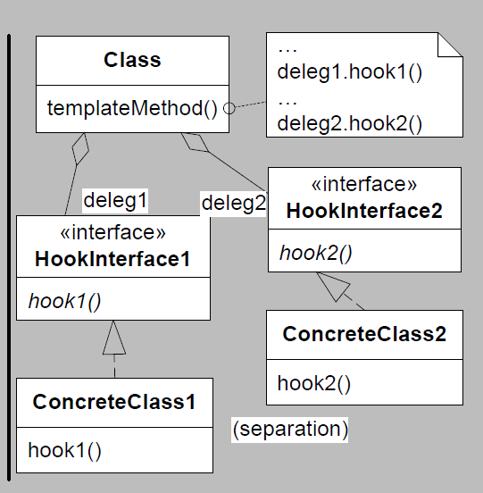
Improved structure
Henrik Bærbak Christensen

Slide 42
Another Case for Composition
Henrik Bærbak Christensen

Slide 43
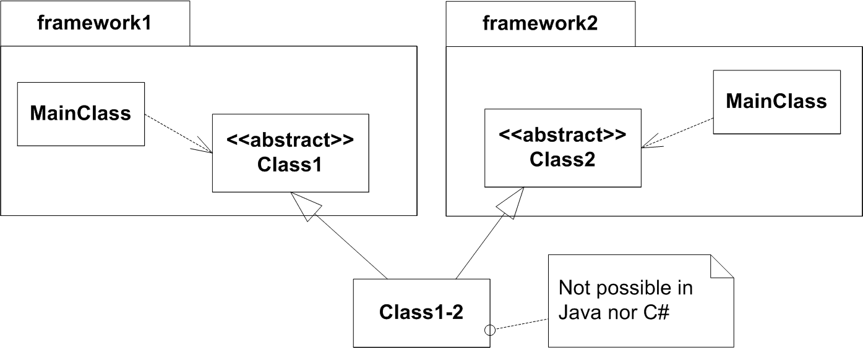
Mixing Two Frameworks
Based upon the inheritance based template method
Henrik Bærbak Christensen

Slide 44
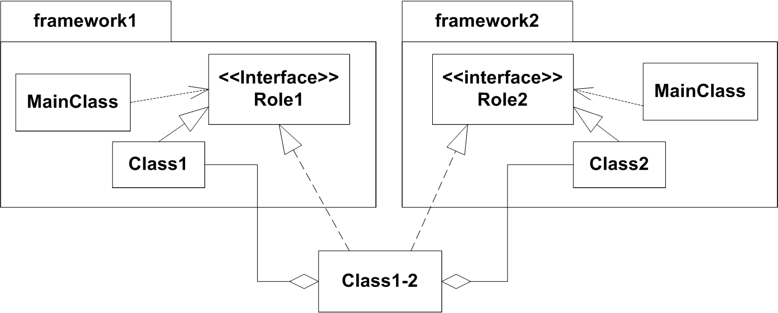
Mixing Two Frameworks
But it does work using compositional template method
Henrik Bærbak Christensen

Slide 45
Software Reuse and
Product Line Architectures
Henrik Bærbak Christensen

Slide 46
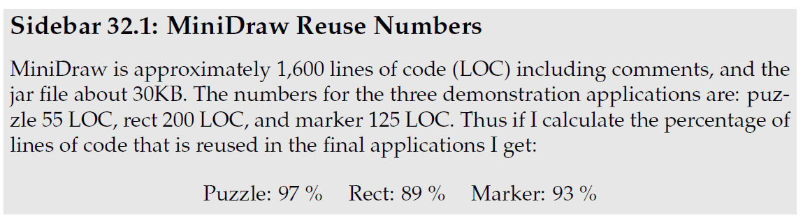
Reuse of software
Software reuse
  High quality (= reliable) software
    If mature and well supported
  Lower cost
    One line of reliable implementation is expensive!!!
    Easier to buy than to develop
  Faster development
    Building apps is faster and cheaper
Henrik Bærbak Christensen

Slide 47
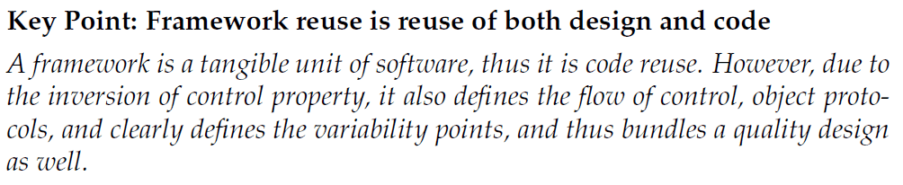
Reuse types
There are many different types of reuse:
  Math.cos(double x) code reuse
  Strategy Pattern design reuse
  Knuth’s binary search alg. design reuse
Frameworks are pretty special:
Henrik Bærbak Christensen

Slide 48
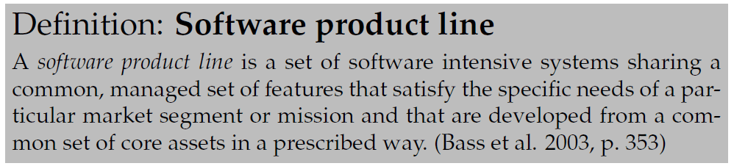
Software Engineering Institute
SEI in Pittsburgh
  (associated with Carnegie Mellon University)
Henrik Bærbak Christensen

Slide 49
Analysis
Characteristics
  software intensive system
  common, managed, set of features
  needs of particular market segment
  developed from a common set of core assets
  prescribed way
Exercise: Compare PayStation
Henrik Bærbak Christensen

Slide 50
Framework/Product Line
In my view the technical aspects of a product line is covered by the framework concept
  A framework is a set of cooperating classes that make up a reusable design for a specific class of software.
Henrik Bærbak Christensen

Slide 51
Organisation Aspect
The organisation aspect, however, is important:
  managed set of features
  developed in a prescribed way
  market segment
A lot of experience from industry point to the fact that software reuse and product line reuse is primarily a organisational challenge!
  Who pays for making the code flexible? Not my project – I want to save my own a…
Reuse is actually quite expensive in practice ☹
Henrik Bærbak Christensen

